Slide 1
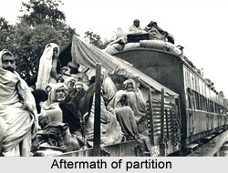
Partition of India

Slide 2
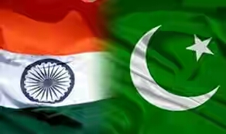
Two Nations Theory
The two nation theory is based on the hypothesis that Muslims differ from Hindus in terms of religious, cultural, social and daily life and that they must establish an independent Muslim state in which they can live freely their identities.
Hindus and Muslims in India were two distinct communities that could not coexist within a single state without dominating and discriminating against the other or without constant conflict; it resulted in the 1947 Partition of India and Pakistan.

Slide 3
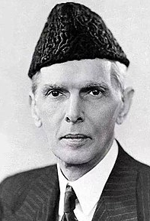
In 1937 in national conference of Hindu mahasava president Savarkar declared- to day India can't be considered an indivisible and well-crystallized nation. Rather primarily there are two nations - Hindu and Muslims. Actually, this is the base of the famous two Nation theory.
Definitely two nation theory was propounded by Savarkar and not by either Muslim league or by Jinnah. Though Jinnah is called the founder of two Nation theory. But the real fact is that he was compelled to leave Congress. Finally, he decided to quit Congress and left the party in1938.

Slide 4
Lahore Resolution
In 1940, the Muslim league conference was held at Lahore. During this time the Bengal Muslim League President was A.K Fazlul Haq and simultaneously he was the chief of Bengal. At Lahore conference Fazlul Haq placed a proposal in front of the delegates, demanding homelands for the Muslims.
In that proposal he mentioned two different, separate and independent states. This proposal when accepted formally by the Muslim league has come to known as Lahore Resolution.

Slide 5
1946 Provincial Election
Provincial elections were held in British India in January 1946 to elect members of the legislative councils of British Indian provinces. The consummation of British rule in India were the 1945/1946 elections. As minor political parties were eliminated, the political scene became restricted to the Indian National Congress and the Muslim League who were more antagonised than ever.
The Congress, in a repeat of the 1937 elections, won 90 percent of the general non-Muslim seats while the Muslim League won the majority of Muslim seats (87%) in the provinces. Nevertheless, the All India Muslim League verified its claim to be the sole representative of Muslim India. The election laid the path to Pakistan.

Slide 6
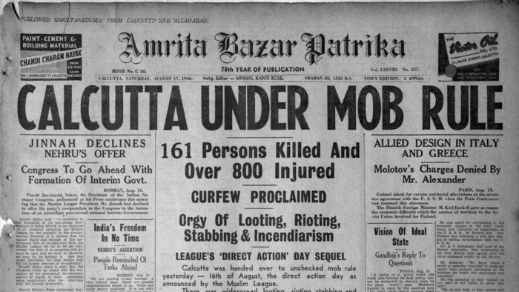
Riot of 1946

Slide 7
The riots completely ramshackled the city life. Food and other essential supplies became scarce, hyperinflation prevailed, and epidemics threatened the metropolis. Calcutta came to be divided into 'communal zones', Hindus and Muslims avoiding each other's areas. For one whole year Calcutta remained a scene of constant communal clashes. Indeed a nexus could rightly be traced between communal outbreaks in Calcutta and Bihar. The circle was completed when the Punjab exploded in March 1947.

Slide 8
Communalism at the popular level provided a new turn to India's institutional politics. The Muslim League warned that civil wars on the Calcutta scale would occur in other parts of the country unless its proposal for the Partition of India was accepted and the Congress suffered a setback and its leadership, excepting Gandhi and Badshah Khan, accepted Partition of the country along religious lines as the 'only alternative'. The turn that events had taken afterwards made a peaceful solution through an agreement between the Congress and the Muslim League a far cry.

Slide 9
India Act 1947
20 Feb 1947: British PM Clement Atlee made the announcement in the House of Commons that it wanted to transfer power to Indian Government by June 1948
Act passed on 5 July 1947
Two Independent Dominions- India & Pakistan
India would include British India except West Punjab, Baluchistan, NWFP, Sind & East Bengal
Indian States free to accede to any of the two Dominions
Each Dominion to have Governor-General appointed by King
The Legislature of the Two Dominions will have the power to make Laws; A new Constituent Assembly for Pakistan

Slide 10
India Act 1947
British Govt would cease responsibility from 15 Aug 1947
The two Dominions along with provinces would be governed by Govt of India Act 1935 till the Constituent Assembly makes the constitution
British Paramountcy over Princely States would cease from 15 August 1947
Emperor of India title abolished, and title omitted from the title of Queen
Office of Secy of State for India would be abolished; work transferred to Secy of State for Commonwealth Affairs

Slide 11
India Act 1947
No Act of British Parliament on Appointed Day or after shall extend to either Dominions as Law unless extended by a law of the Legislature of the Dominion
No order in Council made on appointed day under any Act passed before 15 Aug 1947 will be part of the law of the New Dominion. No order or rule of the UK minister made after 15 August shall extend to India
Division of Armed Forces & Civil Services
An Act of Parliament, Council, Order, Rule not in consistent with 1947 Act will not be in operation

Slide 12
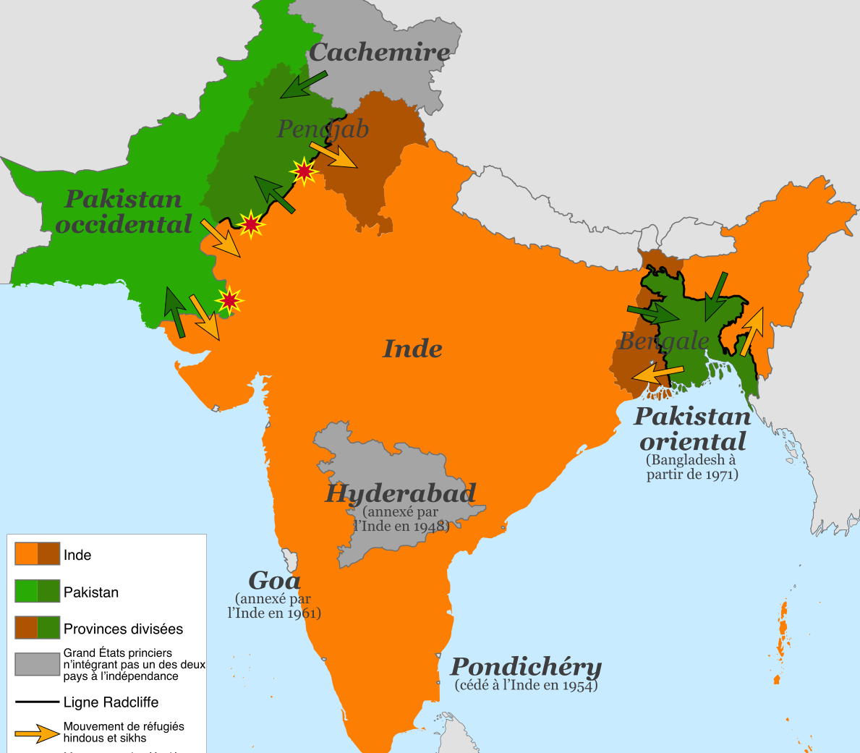
After the Partition of 1947

Slide 13
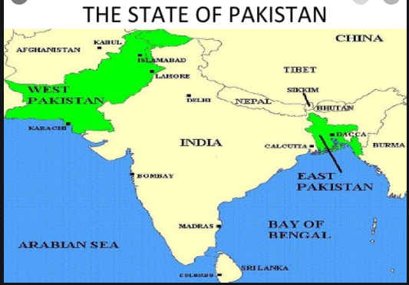

Slide 14
https://www.youtube.com/watch?v=YkLFGWTKPY4&ab_channel=AlJazeeraEnglish
https://www.youtube.com/watch?v=J8MNNN2o3Mc&ab_channel=TheQuint

